Slide 1


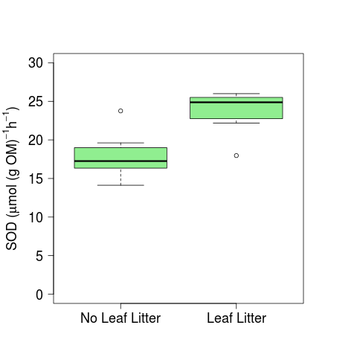
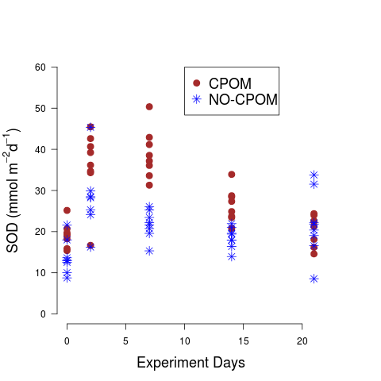
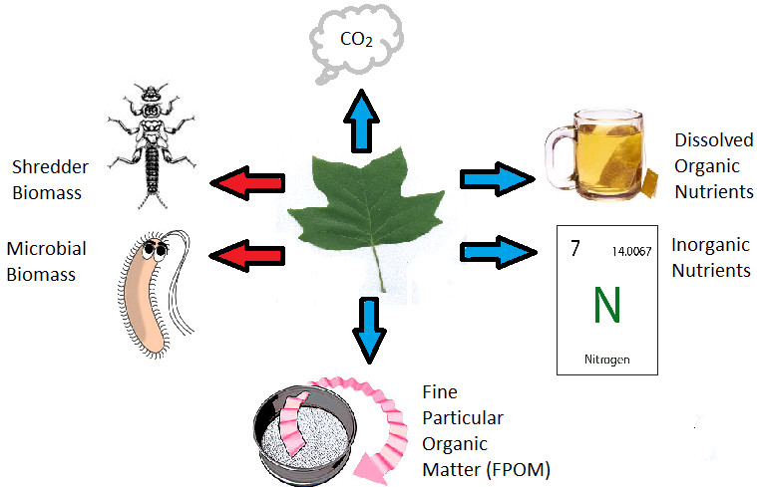
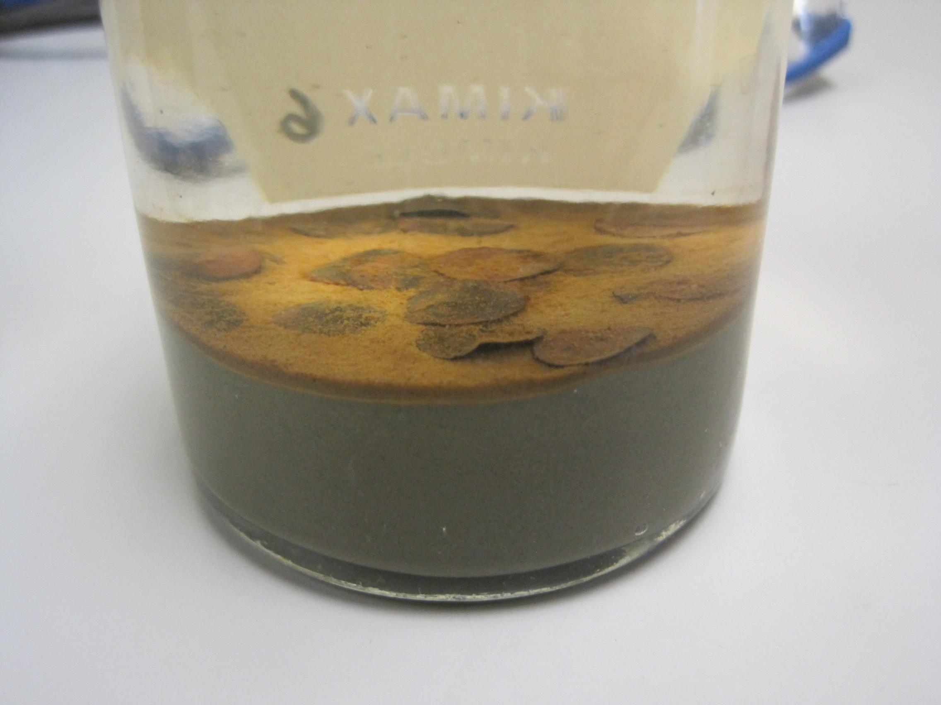
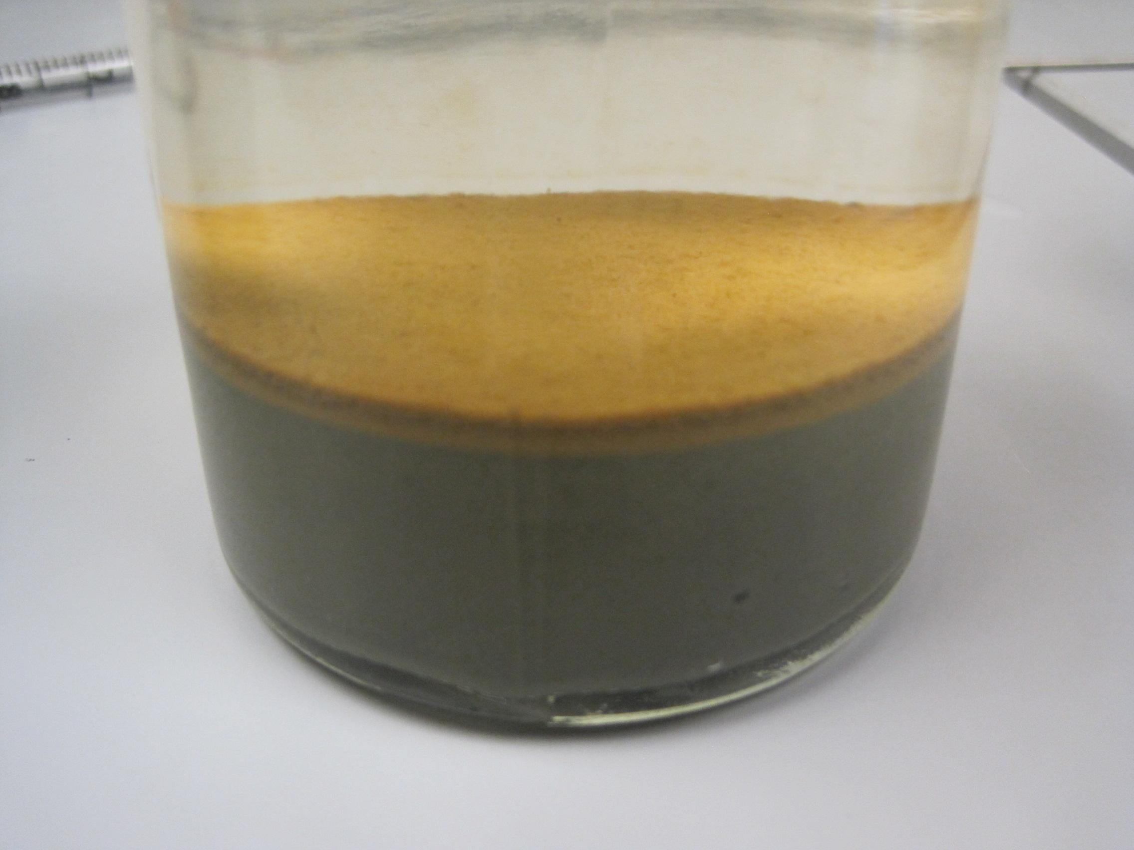
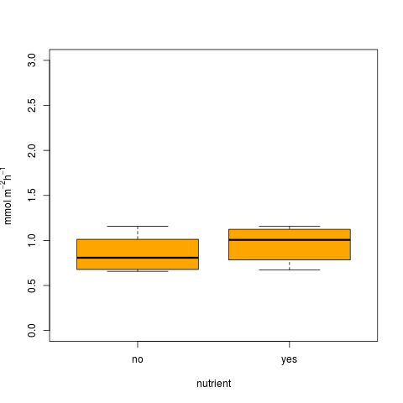
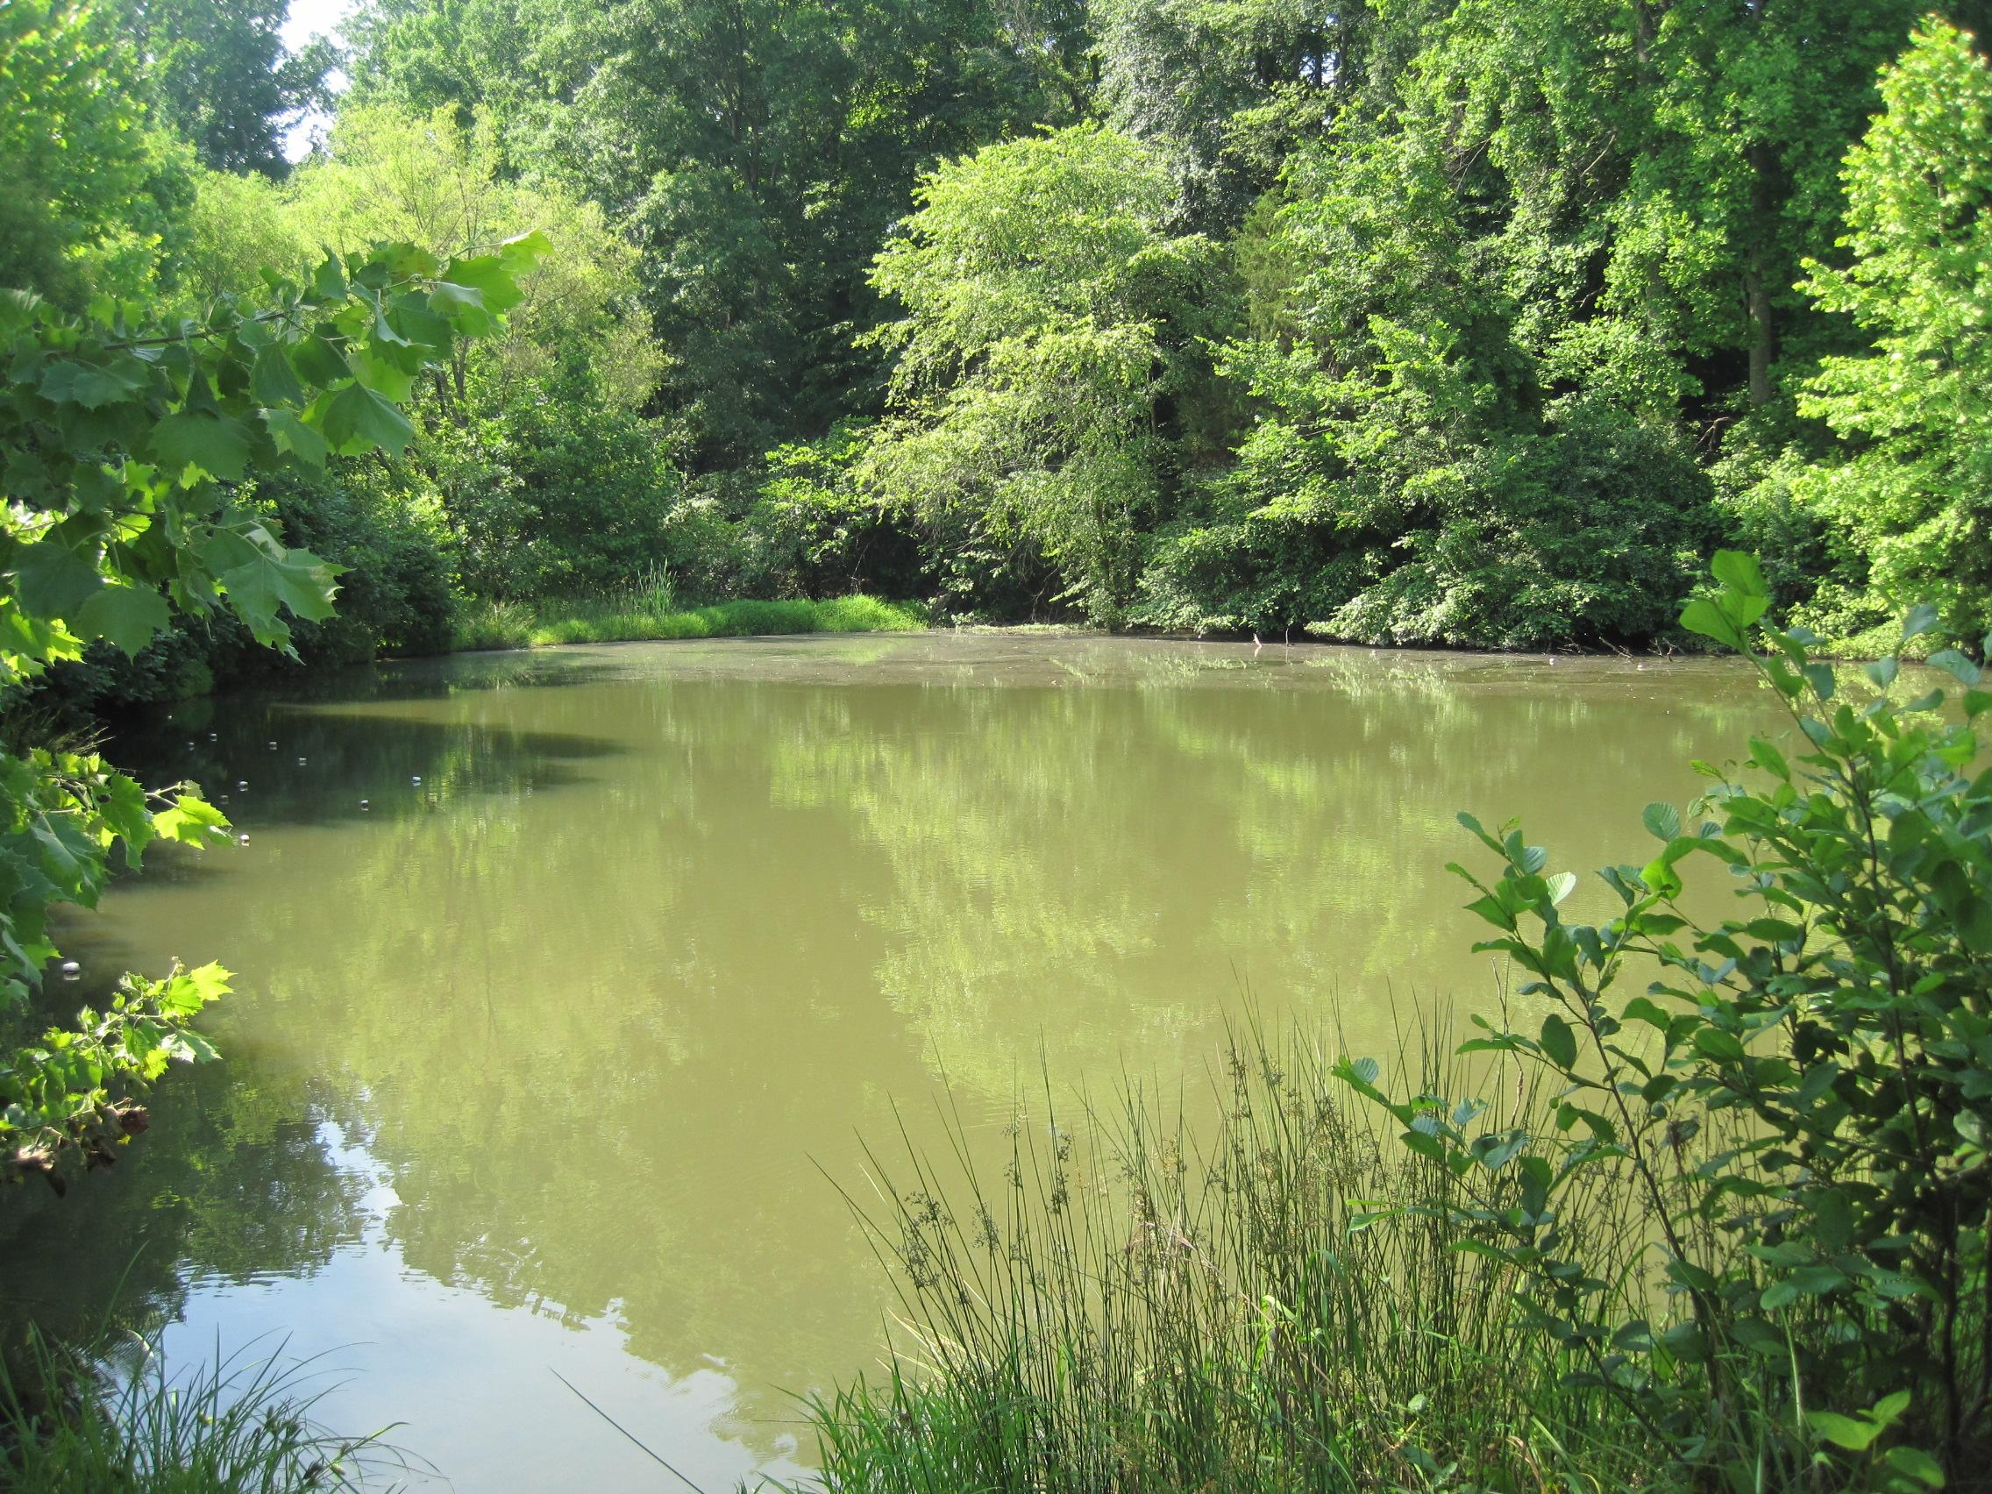
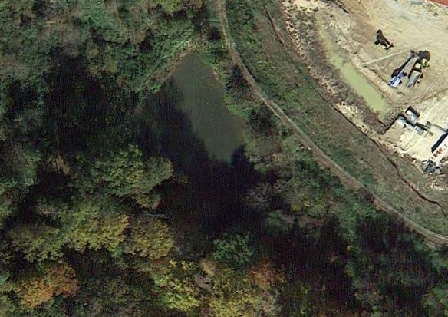
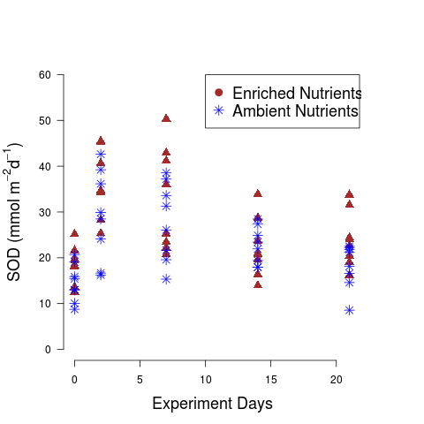
THE EFFECTS OF ALLOCHTHONOUS DETRITUS ON SEDIMENT OXYGEN DEMAND IN A MAN-MADE POND IN CENTRAL VIRGINIA
Kaitlyn D. Peters and Dr. Kenneth Fortino
Longwood University, Farmville, Va
Abstract
Results
On a global scale, the abundance and surface area of man-made ponds is nearly equal to that of natural ponds (Downing 2007). Despite this, little is known about the biogeochemical nutrient cycling of man-made ponds. Recent research suggests that leaf litter is an important resource in ponds because it is abundant, variable, and decomposes slowly (Fortino unpublished data). In order to better understand its significance, an experiment was devised that allowed us to simultaneously test the effects of leaf litter on sediment oxygen demand (SOD), and to see if leaf litter alters SOD in a nutrient enriched system. The experiment utilized a complete factorial design, with four BOD bottles for each treatment level. To perform the experiment, sediment samples were collected on 29 May 2014 and water samples on 9 June 2014 from a local, man-made pond, Lancer Park Pond. These samples were placed into 300 ml BOD bottles to mimic a man-made system, and then stored in a cool, dark place between sample runs. It was found that leaf litter, and to a lesser degree nutrient enrichment, increased overall sediment oxygen demand in the system. Spectrometry scans revealed that the labile organic matter greatly decreased in the leaf litter treatments, eventually stabilizing around the last two samples runs. Based on additional analyses, we also found evidence suggesting that the kind of organic matter introduced to the system was more important than the abundance.
Methods
Figure 2: A comparison of the sediment oxygen demand in BOD bottles with leaf litter and those without after standardized by the organic matter abundance per bottle. Statistical analyses suggests that CPOM significantly affects sediment oxygen demand (SOD) in a man-made system. In addition, since these results were standardized by their organic matter content, we can see that the type of organic matter is significant.
A factorial design was creating using CPOM and nutrient enrichment treatments
Sediment samples were collected 29 May 2014 from Lancer Park Pond using an eckman-dredge
Replacement water samples were collected 9 June 2014 from Lancer Park Pond by submersion at Z=0.5m
BOD bottles were loaded with 100ml of sediment slurry and 200ml of replacement water
Nutrient enrichment treatments were created by adding 300 micrograms/liter of DIN and 30 micrograms/ liter of DIP to the replacement water
The CPOM treatments were created by adding 20 leaf disks of 10 mm diameter to each CPOM treatment bottle
Sediment oxygen demand was determined using the Winkler’s Method (Carpenter 1965)
The proportion of organic matter in the sediments and CPOM was determined by loss upon ignition.
Background
Leaf litter provides resources for ponds.
Figure 3: A comparison of the sediment oxygen demand in bottles with leaf litter and those without over the course of the five experiment runs. These results have been standardized by organic matter content in each bottle. We can see that the bottles containing leaf litter had a spike in SOD on the second run but continued to decline as time went on.
6A
6B
Figure 6: A. An example of a BOD bottle with CPOM present. B. An example of a BOD bottle without CPOM.
Figure 1. Leaf litter that falls into ponds becomes coarse particulate organic matter (CPOM) in the sediments. The organic matter in the CPOM can be used as a food resource by shredding macroinvertebrates, and microbial (fungi and bacteria) communities (red arrows). The organic matter in the CPOM can also serve as a source of resources for organisms in the pond that do not use the CPOM directly (blue arrows). Soluble organic compounds leach from CPOM and produce dissolved organic matter. The consumption and metabolic activity of organisms using CPOM convert the CPOM mass into inorganic nutrients and CO₂, as well as fine particulate organic matter. (figure adapted from Gessner et al. 1999).
Figure 7: Landscape and aerial views of Lancer Park Pond (LPP). LPP is a stormwater pond with a surface area of 0.06 ha and a maximum depth of 1.5m.
Figure 4: A comparison of the SOD in BOD with leaf litter and those without after organic matter standardization. As with the leaf litter, it was found that the nutrient enriched
Conclusions
Literature Cited
What is the contribution of leaf litter to sediment oxygen demand in man-made ponds?
Does leaf litter affect sediment oxygen demand by altering the effects of nutrient enrichment?
Acknowledgments
Figure 5: A plot of the SOD data collected from BOD bottles with and without nutrient enrichment over the course of the five experiment runs.

